Slide 1
Trading Gold with Machine Learning

Slide 2
None of the information contained here constitutes an offer (or solicitation of an offer) to buy or sell any currency, product or financial instrument, to make any investment, or to participate in any particular trading strategy.

Slide 3
Problem Statement
As a quant developer in a trading firm, my firm would like to explore trading gold. I have thus been tasked to find a profitable strategy and build a trading bot to trade the market

Slide 4
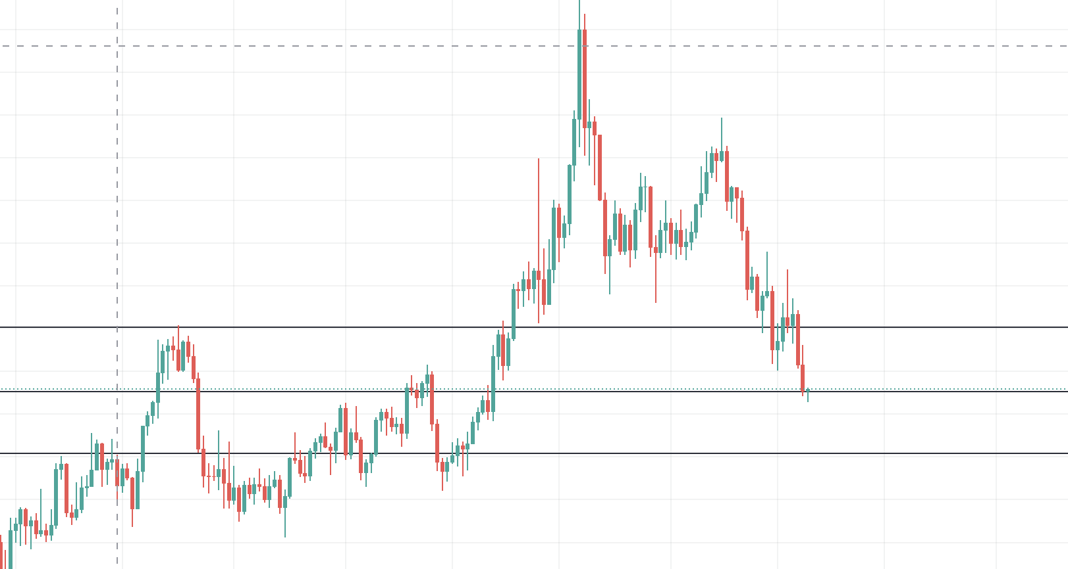
Terminology
Long
Take Profit, Stop Loss
Take Profit (TP)
Price Now
Stop Loss (SL)
Notes:
Each trade will either be a long or short trade. When you put a trade, it will come with tp and sl

Slide 5
Terminology
Short
Take Profit, Stop Loss
Stop Loss (SL)
Price Now
Take Profit (TP)
Notes:
Remove price on right side and optimize picture
Explain that every trade will either be a long or short

Slide 6
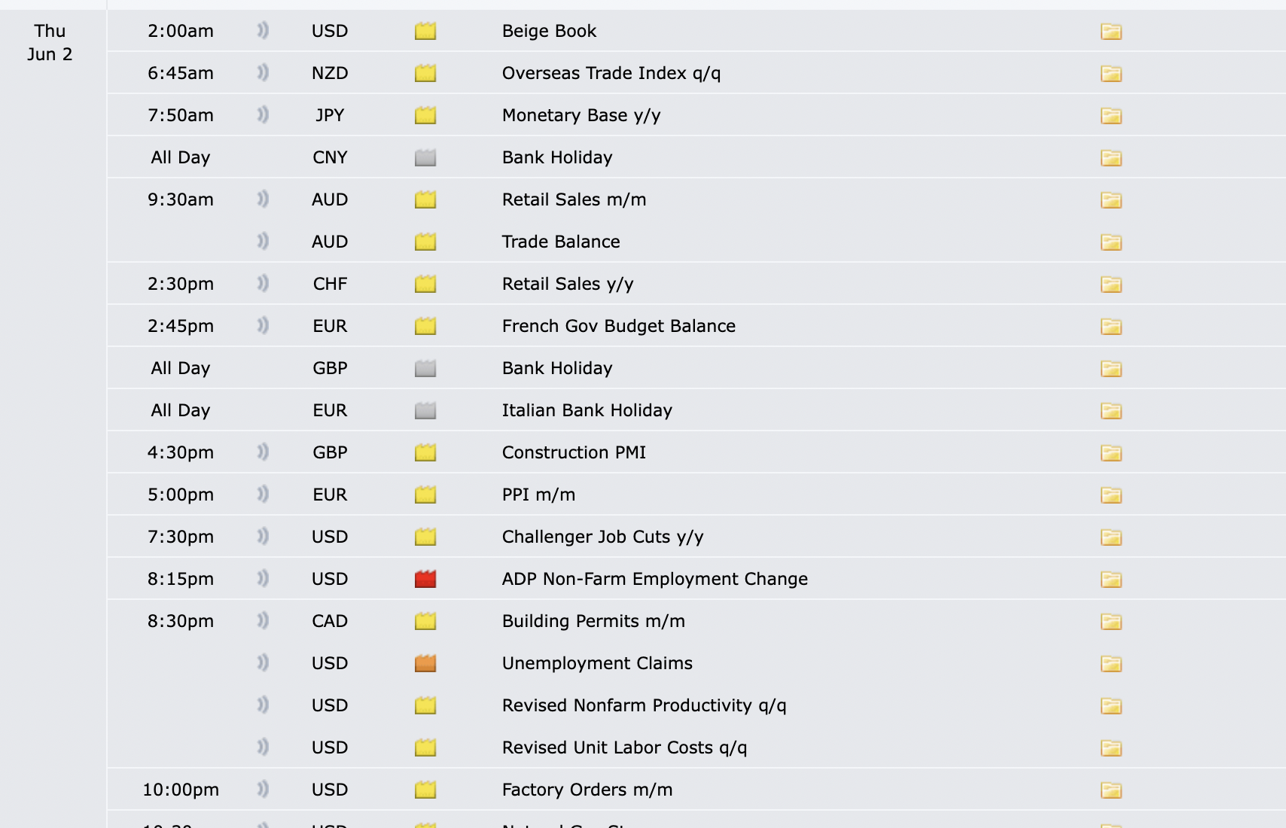
Forex Factory Website Events List
Notes:
Note: We can see that the events for June 2022 are already published.
Red means it is an important event, and orange is next in importance.
We can hence preset our bot to collect candles when the time comes.

Slide 7
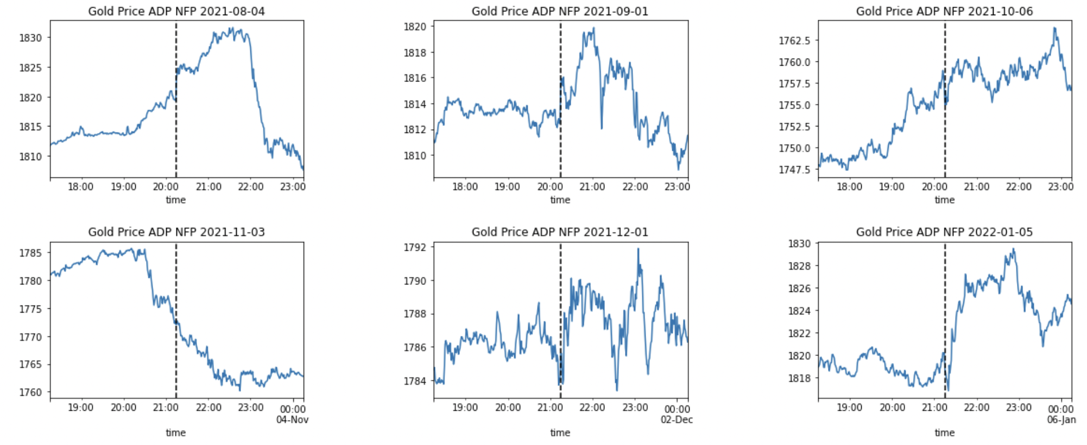
Volatility
Volatility of any 10 candles in time | Volatility of 10 candles after event
0.35 | 0.78

Slide 8
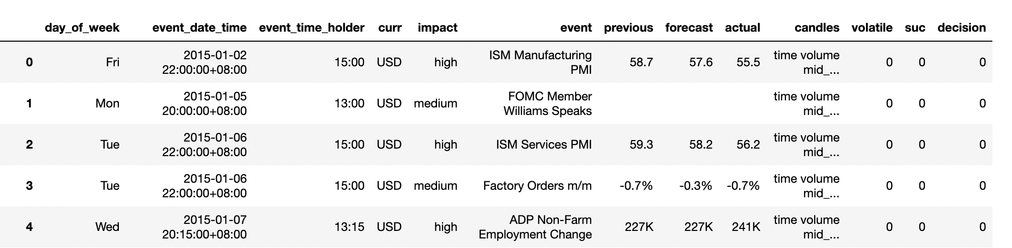
Example of dataframe after scraping past events for model training
Timezone for Forex Factory is in EST, so we convert to SGT

Slide 9
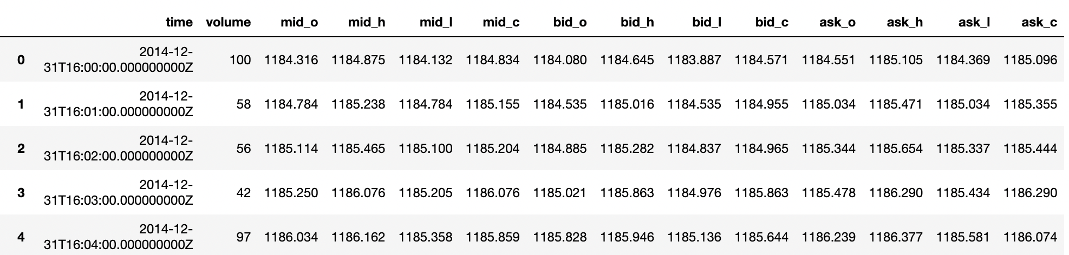
Data Mining
Candles obtained through Oanda
Oanda is a US based broker specializing in Forex
Serves SG clients
Convert UTC Time to SGT

Slide 10
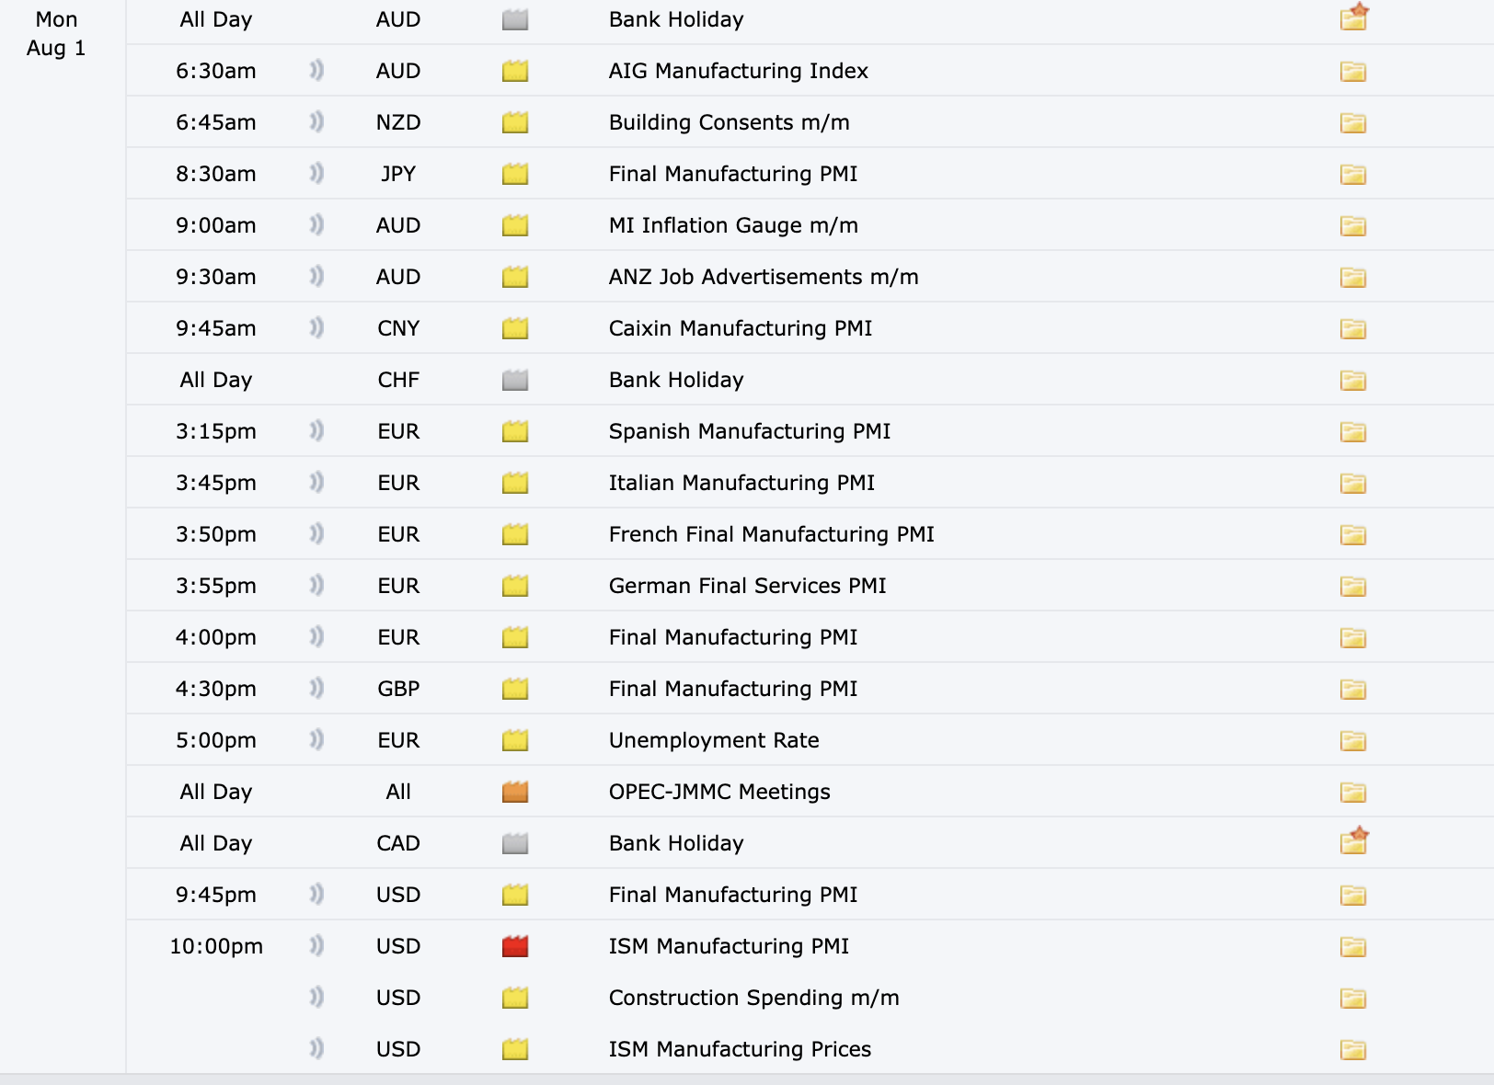
Sample Event

Slide 11
LSTM Model: Sequence of events for trade execution
Event Start time
10:03:02 pm to
10:03:58 pm
Candle 1
9:59 pm
Candle 2
10:00 pm
Candle 3
10:01 pm
Candle 4
10:02 pm
Candle 5 Open
10:03:01 pm
Candle 5 Close
10:03:59 pm
Bot does nothing
Bot presets to collect candle at 10:03:01 pm for candles 1-4
Bot sends predicted price to place trade with broker
LSTM Model Makes Prediction for Candle 5, 10:03 pm close price
Notes:
Explain differences

Slide 12
LSTM Input/ Model Training
 | X–TRAIN INPUT | Y-TRAIN INPUT
EVENT 1
EVENT 2
Candle 1
Prediction / (Y) :Candle 5
Candle 2 (event start time)
Candle 3
Candle 4
Candle 1
Prediction / (Y) :Candle 5
Candle 2 (event start time)
Candle 3
Candle 4
Notes:
Note X Input is a 3 dimensional array e.g. [3000 events, 4 rows (for each timestep), 1 column] ; shape (3000,4,1).
4 candles to predict 1 Y (candle 5)
Minmax scaled

Slide 13
Architecture of LSTM
LSTM LAYER 1, RETURN SEQUENCE, DROPOUT 0.2
LSTM LAYER 2, RETURN SEQUENCE , DROPOUT 0.2
LSTM LAYER 3, RETURN SEQUENCE , DROPOUT 0.2
LSTM LAYER 4, DROPOUT 0.2
DENSE, UNITS = 1
Notes:
Optimizer adam, loss mse

Slide 14
LSTM Model: Backtesting
Event Start time
10:03:02 pm to
10:03:58 pm
Event Start
10:00 pm
Candle 5 Open
10:03:01 pm
Candle 5 Close
10:03:59 pm
Candle 6
10:04 pm
Candle 7, 8, 9 …
Bot collects candles
Trade here
Backtester starts backtesting until prediction hits stop/loss or take profit (taking into account bid-ask spread)
LSTM Model Makes Prediction for Candle 5, 10:03 pm close price
Notes:
Explain differences

Slide 15
Cross Validation
Period 1 | Period 2 | Period 3 | Period 4 | Period 5 | Period 6 | Period 7 | Period 8 | Period 9 | Period 10
Jan 15 – Aug 15 | Aug 15 – Mar 16 | Mar 16 - Nov 16 | Nov 16 – Jun 17 | Jun 17 – Feb 18 | Feb 18 – Nov 18 | Nov 18 – Sep 19 | Sep 19 – Jul 20 | Jul 20 – Jul 21 | Jul 21 – Mar 22
CV 1:
Train
Test
Train
Test
Train
CV 2:

Slide 16
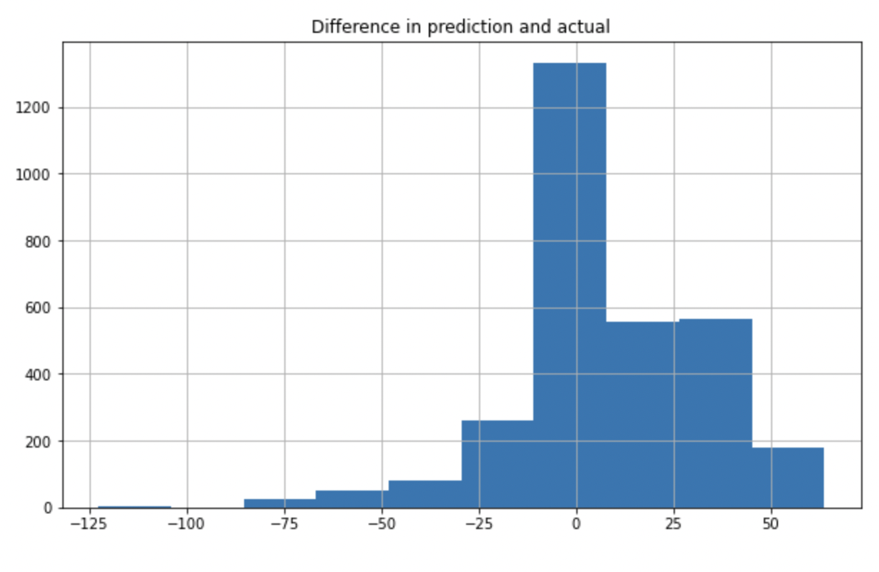
Difference between prediction and actual price
Mean: $6.70

Slide 17
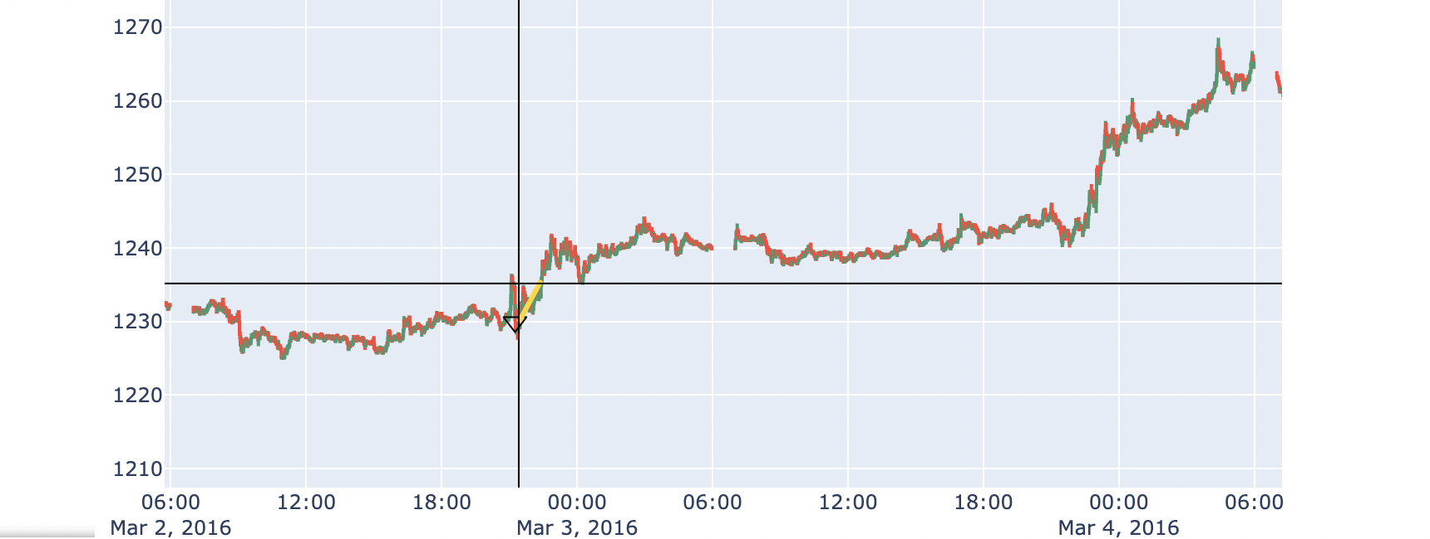
Analysis of Trade

Slide 18
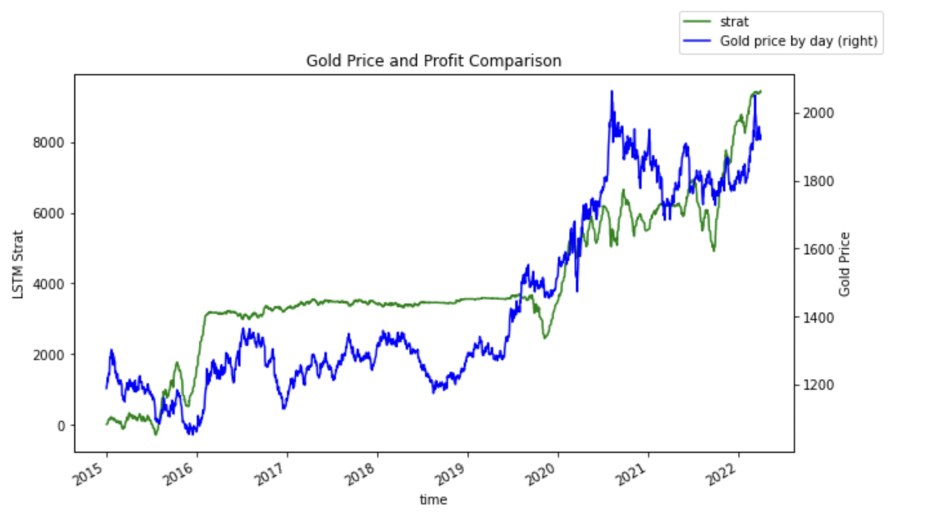
Analysis of profits against movement in gold

Slide 19
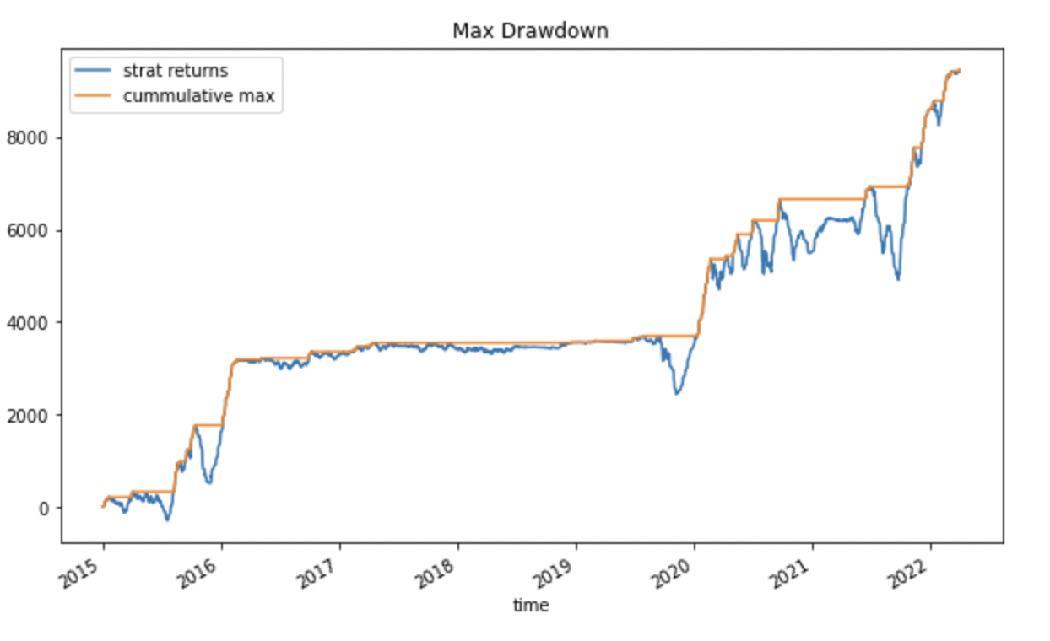
Max Drawdown
Max Drawdown:
$2011
Max Drawdown Period:
603 days
$2011
603 days

Slide 20
Results (2015 – 2022 March)
Total Trades: 3049 | Success Percentage | Profit per unit
Long | 55% | $8532
Short | 47% | $889
Total | 51% | $9442

Slide 21
Trade Metrics
Risk Parameters
Risk/Reward per trade | 1:1
Units per trade | 2
Max risk per trade | $200
Max capital drawdown (Base capital $10k) | $5978
Rate of Return
Base Capital | $10,000
Leveraged Capital (x5) | $50,000
Total Profit | + $18,844
Daily Financing | - $3,082
Net Profit | $15,762
Total Years | 7.25
Profit per year | $2,175
Rate of return per year | 21.7%

Slide 22
Demo

Slide 23
After Thoughts
Blackbox Model
Model usually over/underpredicts the 11th candle
Need to train more/fine tune architecture

Slide 24
Future Works
Modelling
Train and finetune More
Bidirectional-LSTM Model
Infrastructure
C++/Rust for improved speed
Streaming API vs Rest API
Put in cloud and auto-run
Usage
Black Swan Events
Other Instruments (e.g. Forex)

Slide 25
Forex Factory Website Events List
Clean
Clean
Notes:
Note: We can see that the events for June 2022 are already published.
Red means it is an important event, and orange is next in importance.
We can hence preset our bot to collect candles when the time comes.

Slide 26
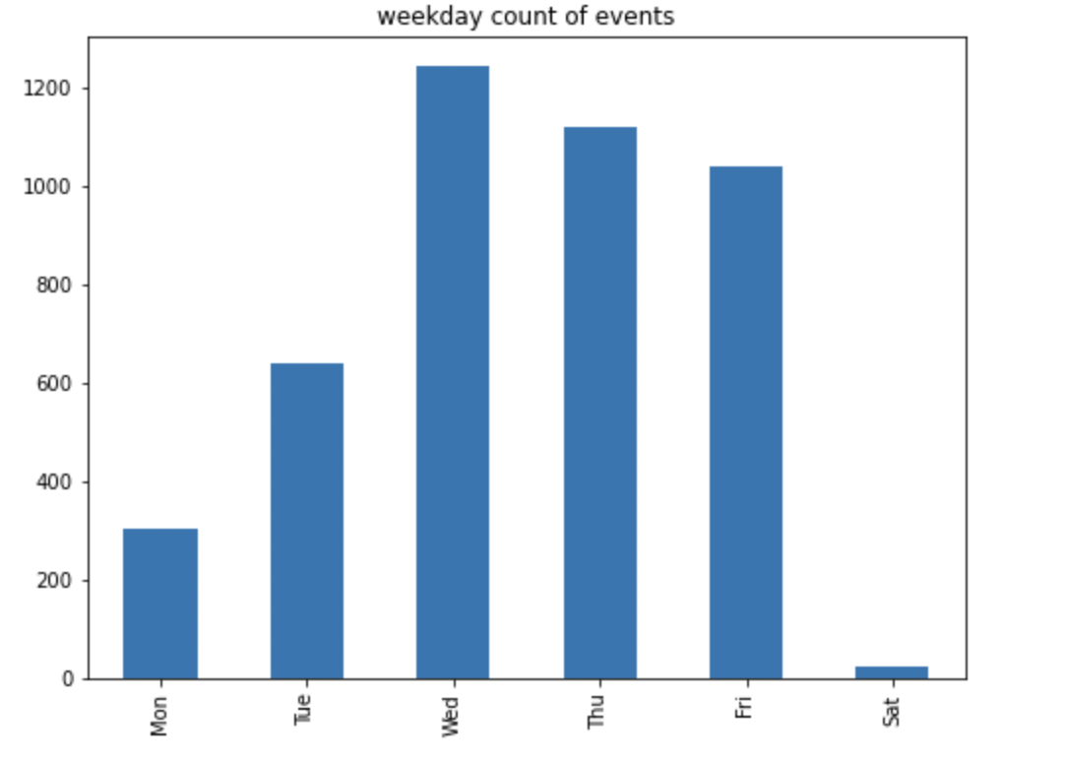
EDA – Weekday of Events

Slide 27
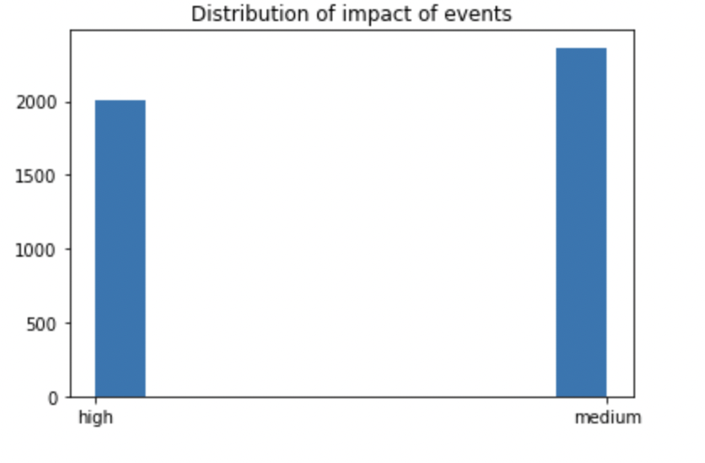
EDA- Impact of events

Slide 28
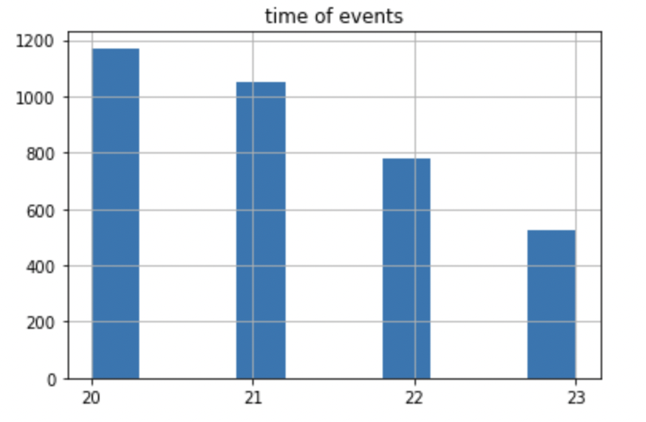
EDA – Time of Events

Slide 29
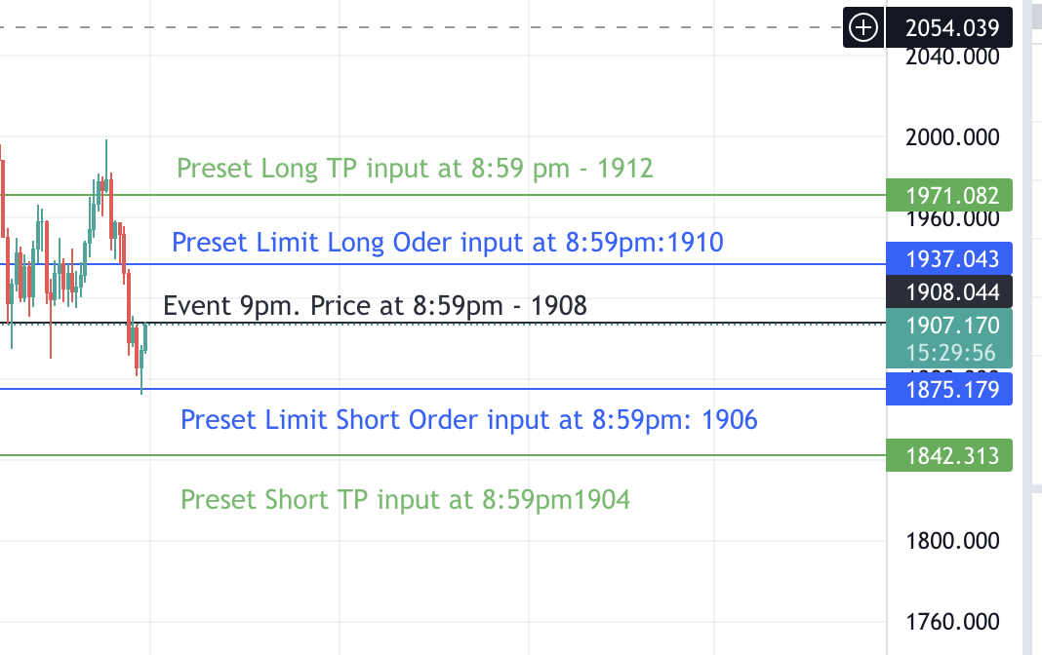
Baseline Model- Momentum
Notes:
The main strategy that this ML model is built on is as shown above. We know that our event time is at 9pm. At 8:59, we will get the price. For example, The price of gold could be 1908. We will then put in a long order at 1910, with take profit 1912, and a short order at 1906, and take profit at 1904. The rationale for this is that the impact of the event will cause the price to jump in either direction. However, we do not know which direction it will jump. Hence, we will input both directions, as we believe that after it hits our order limit, the price will continue to move further to our take profit point. Each order is also set to expire at 5 mins after the event, so that only 1 will trigger.
Indicate trigger point. Put dollar sign. Indicate stop loss and take profit on different slide

Slide 30
Baseline Model- Momentum
Example: Event at 9pm
At 8:59pm Preset Long Limit Order – $1904 (Trigger Price)
8:59pm Price - $1902
At 8:59pm Preset Short Limit Order - $1900 (Trigger Price)
Notes:
The main strategy that this ML model is built on is as shown above. We know that our event time is at 9pm. At 8:59, we will get the price. For example, The price of gold could be 1908. We will then put in a long order at 1910, with take profit 1912, and a short order at 1906, and take profit at 1904. The rationale for this is that the impact of the event will cause the price to jump in either direction. However, we do not know which direction it will jump. Hence, we will input both directions, as we believe that after it hits our order limit, the price will continue to move further to our take profit point. Each order is also set to expire at 5 mins after the event, so that only 1 will trigger.
Indicate trigger point. Put dollar sign. Indicate stop loss and take profit on different slide

Slide 31
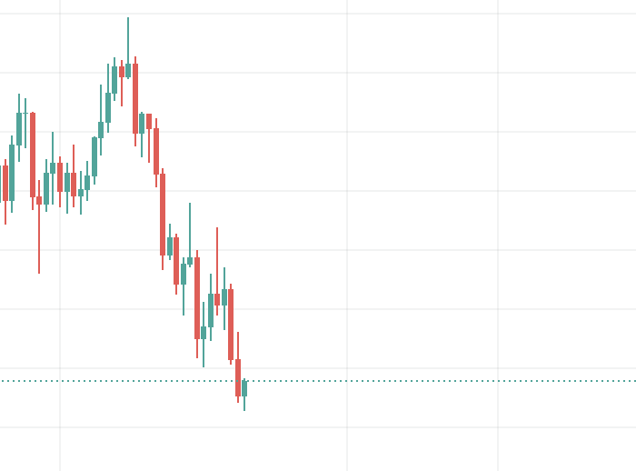
Baseline Model- Long triggered
Example: Event at 9pm
Long order Take Profit - $1906
Long order Triggered - $1904
Event-Price/ Long order Stop Loss - $1902
Notes:
The main strategy that this ML model is built on is as shown above. We know that our event time is at 9pm. At 8:59, we will get the price. For example, The price of gold could be 1908. We will then put in a long order at 1910, with take profit 1912, and a short order at 1906, and take profit at 1904. The rationale for this is that the impact of the event will cause the price to jump in either direction. However, we do not know which direction it will jump. Hence, we will input both directions, as we believe that after it hits our order limit, the price will continue to move further to our take profit point. Each order is also set to expire at 5 mins after the event, so that only 1 will trigger.
Indicate trigger point. Put dollar sign. Indicate stop loss and take profit on different slide

Slide 32
Baseline Model- Momentum
Example: Event at 9pm
Event-Price/ Short order Stop Loss - $1902
Short Order Triggered – $1900
Short order Take Profit - $1898
Notes:
The main strategy that this ML model is built on is as shown above. We know that our event time is at 9pm. At 8:59, we will get the price. For example, The price of gold could be 1908. We will then put in a long order at 1910, with take profit 1912, and a short order at 1906, and take profit at 1904. The rationale for this is that the impact of the event will cause the price to jump in either direction. However, we do not know which direction it will jump. Hence, we will input both directions, as we believe that after it hits our order limit, the price will continue to move further to our take profit point. Each order is also set to expire at 5 mins after the event, so that only 1 will trigger.
Indicate trigger point. Put dollar sign. Indicate stop loss and take profit on different slide

Slide 33
Baseline Momentum – Non ML, trade every event
Long Win percentage | 39%
Short Win percentage | 36%
Total Win Percentage | 37%
Notes:
Pure ml model without trading

Slide 34
Baseline Model-Reversal
Notes:
The main strategy that this ML model is built on is as shown above. We know that our event time is at 9pm. At 8:59, we will get the price. For example, The price of gold could be 1908. We will then put in a long order at 1910, with take profit 1912, and a short order at 1906, and take profit at 1904. The rationale for this is that the impact of the event will cause the price to jump in either direction. However, we do not know which direction it will jump. Hence, we will input both directions, as we believe that after it hits our order limit, the price will continue to move further to our take profit point. Each order is also set to expire at 5 mins after the event, so that only 1 will trigger.

Slide 35
Reversal
Long Win percentage | 38%
Short Win percentage | 39%
Total Win Percentage | 38%

Slide 36
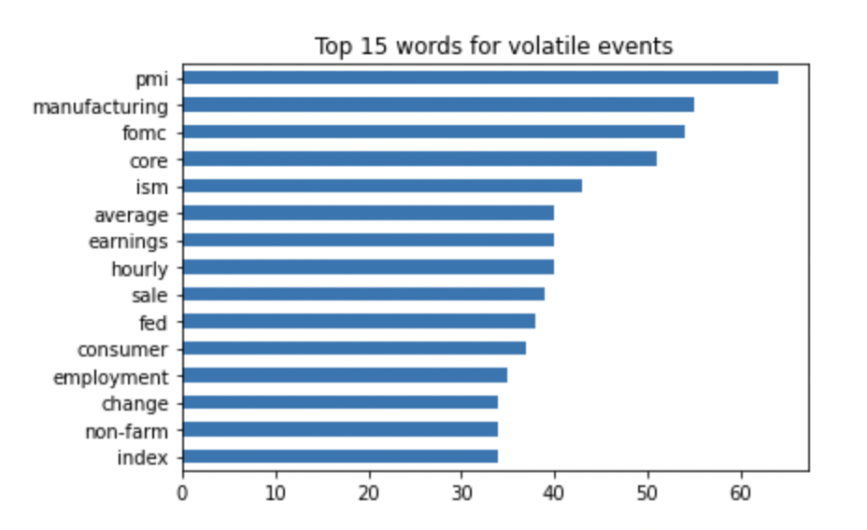

NLP MODEL: Top words for Volatile Events

Slide 37
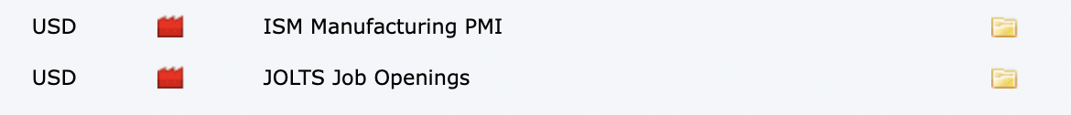
NLP Model - Long triggered
Example:
Long order Take Profit - 1906
Long order Triggered - 1904
Event Price - 1902
Notes:
The main strategy that this ML model is built on is as shown above. We know that our event time is at 9pm. At 8:59, we will get the price. For example, The price of gold could be 1908. We will then put in a long order at 1910, with take profit 1912, and a short order at 1906, and take profit at 1904. The rationale for this is that the impact of the event will cause the price to jump in either direction. However, we do not know which direction it will jump. Hence, we will input both directions, as we believe that after it hits our order limit, the price will continue to move further to our take profit point. Each order is also set to expire at 5 mins after the event, so that only 1 will trigger.
Indicate trigger point. Put dollar sign. Indicate stop loss and take profit on different slide

Slide 38
NLP Results
 | Precision | Best Threshold | Max Profit
Log Reg | 22% | 85% | 0
ET | 22% | 90% | 0
SVM | 22% | 70% | 0
RF | 22% | 90% | 0
ADA | 21% | 55% | 0
GB | 21% | 75% | 0
XGB | 22% | 90% | 0
NB | 22% | 90% | 0

Slide 39
Sequence of events for LSTM backtester
Bot starts backtesting from candle 5 till trade ends.
Event Start time
Candle 1
8:14 pm
Candle 2
8:15 pm
Candle 3
8:16 pm
Candle 4
8:17 pm
Candle 5
8:18 pm
Candle 6
8:19 pm
Candle 7
8:20 pm
Backtest Prices | Entry price | Ending price
Short (Note that we use bid ask high low to ensure that our backtesting is robust and strict) | 8:18pm bid ‘open’ | Take Profit: ‘ask low’ crosses below take profit price Stop loss: ‘ask high’ crosses above stop loss price
Long | 8:18pm ask ‘open’ | Take Profit: ‘Bid high’ crosses above take profit price Stop loss: ‘Bid low’ crosses below Stop loss price
Pre- Event Candle. Note that our bot is trained on close prices (e.g. candles 1-4) as we cannot possibly know if we long or short at this point. The prediction is done using close prices as inputs as well.
Notes:
Note: You may wonder why we start backtesting from 8:18pm when our bot executes the trade at 8:18pm. This is because our backtester takes the ‘opening’ bid/ask at 8:18. It then backtests on the high/low of bid/ask from 8:18pm onwards. This is to ensure that we capture any take profit/stop loss that happens in the candle itself. Though from our initial backtest results, the transaction close times is never on the same candle so it doesn’t matter either way.
To provide an example for the backtester, let’s say our entry is $2000 at 8:18pm and take profit for long is $2001 . At 8:20pm, if the ‘bid high’ is at $2002, our bot will record a gain of $1 (Not $2) as it has deemed to have crossed the $2001 take profit point. It will then close and record the trade.

Slide 40
Appendix SARIMAX
Model | Dataset | Built? | Input | Output | Profitability | Rationale for model
SARIMAX | Oanda Day Candles | Yes | Daily price of gold | +1 day timestep predicted price of gold | Win rate (45-49%): Estimated loss per ounce: $150 | We want to see if we can trade gold based on daily prices

Slide 41
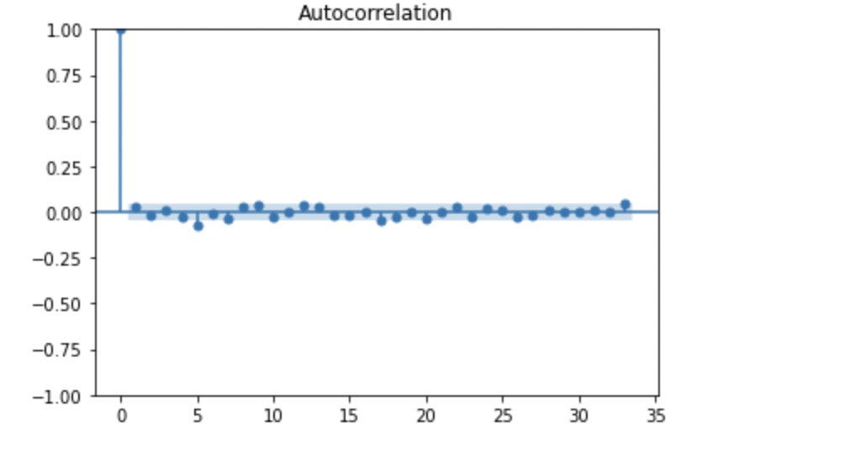
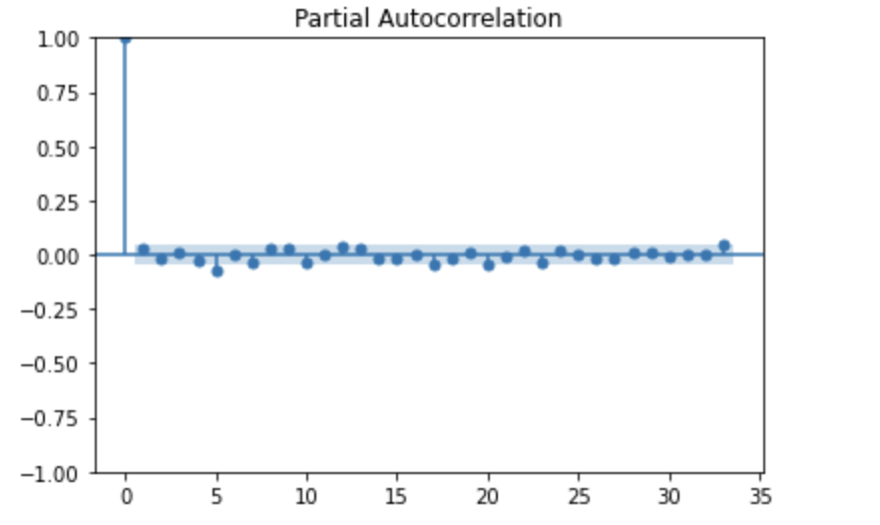
EDA For SARIMAX
Notes:
From the ACF (Diff 1), we can see that the possible MA is 5
From the PACF (Diff 1), we can see that the possible AR is 5
There also seem to be some seasonality at intervals of 5. This is perhaps due to the correlation between each week’s weekday candle. We have thus fitted a Sarima model.

Slide 42
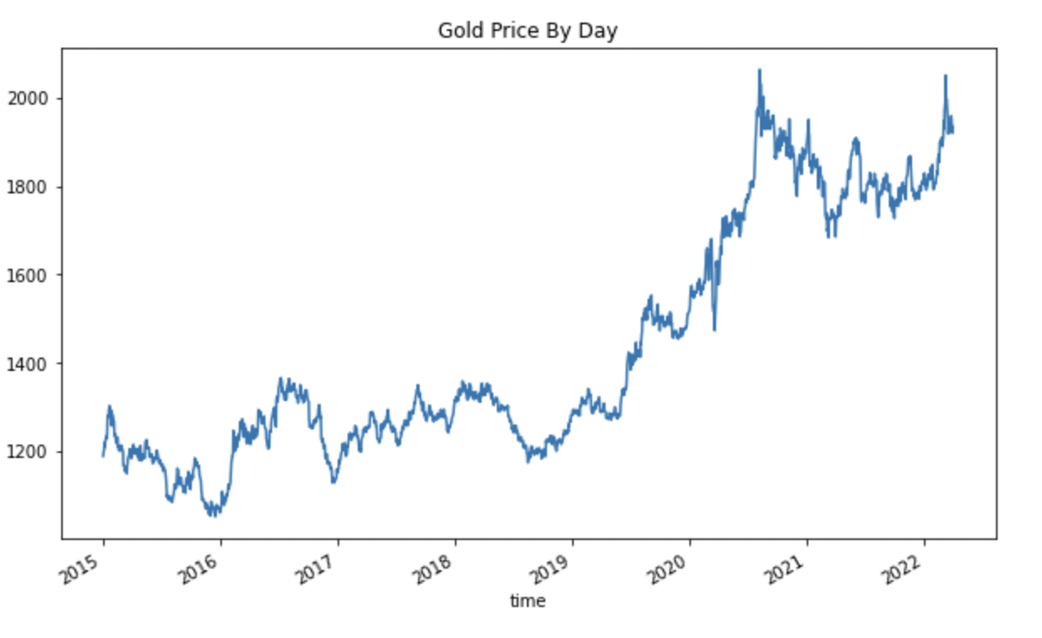
Gold Price

Slide 43
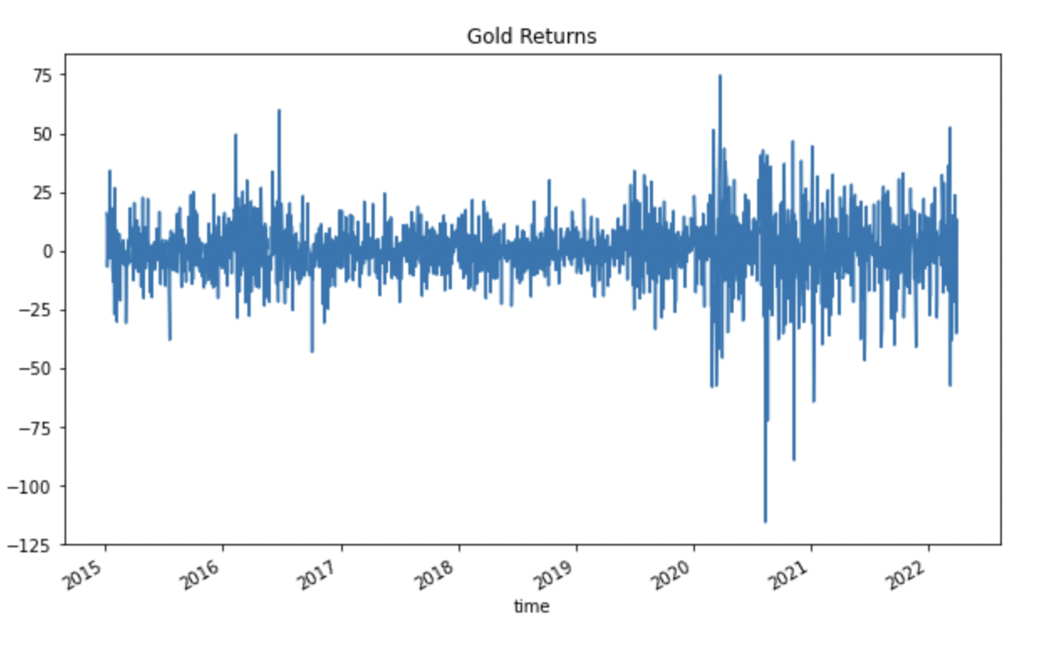
ARIMA – Returns are stationary

Slide 44
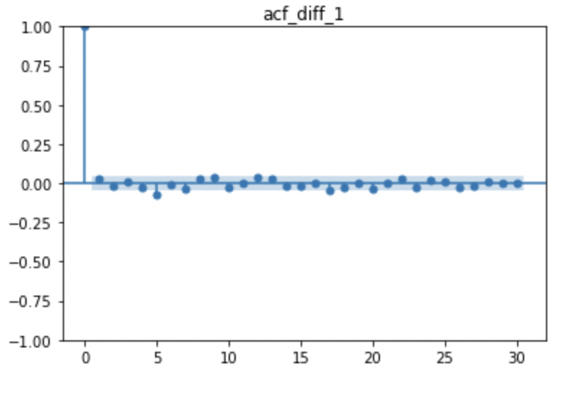
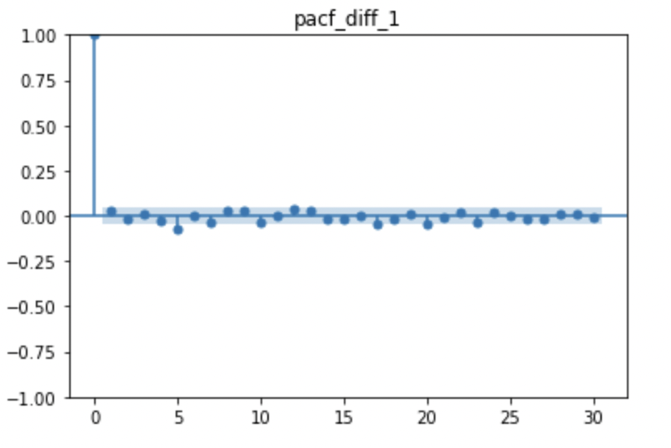
ARIMA – Finding AR/MA

Slide 45
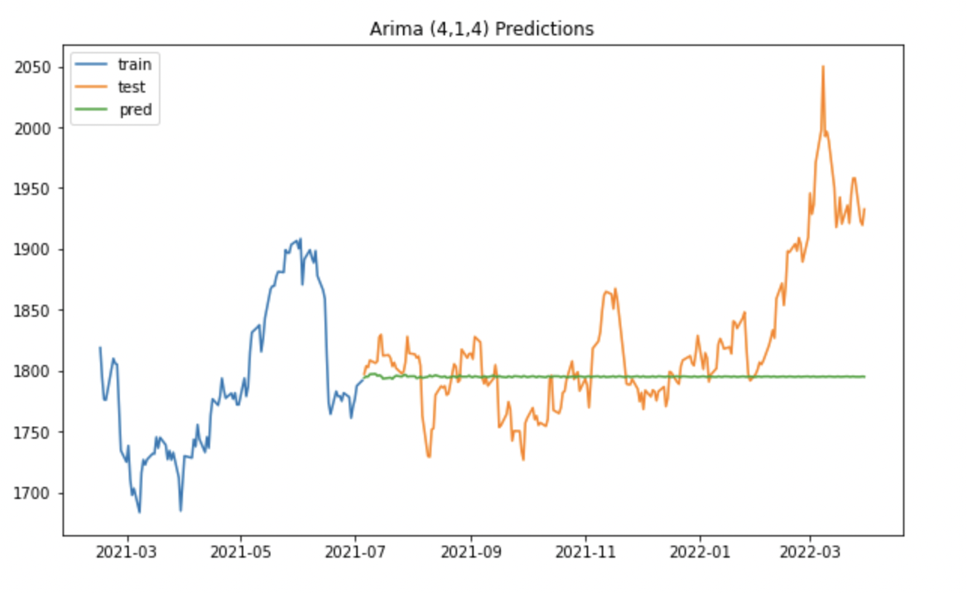
ARIMA (4,1,4)
RMSE: 64
Notes:
Predict 8 months prices away

Slide 46
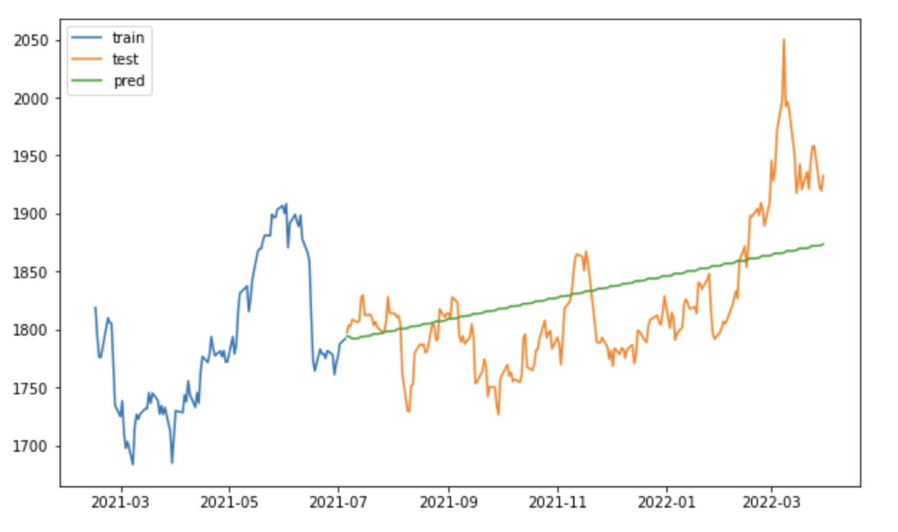
SARIMA (5,1,5) X (0,1,0,5)
RMSE: 48

Slide 47
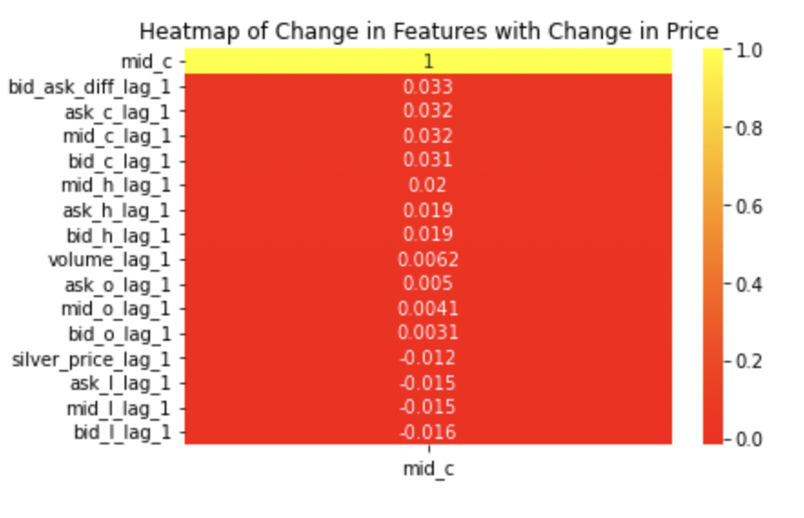
Heatmap for Exog Variables for SARIMAX

Slide 48
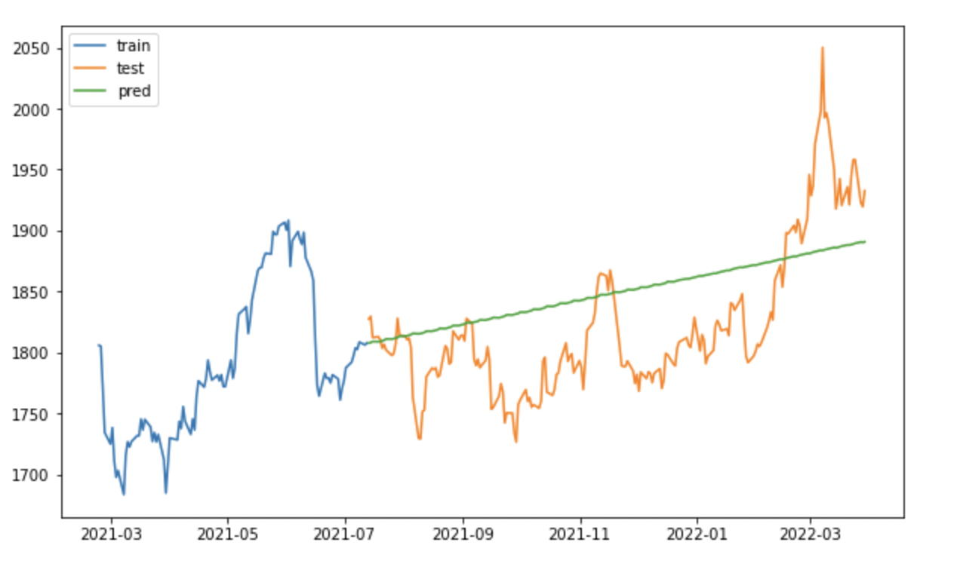
SARIMAX (5,1,5) X (0,1,0,5) w Silver
RMSE: 54

Slide 49
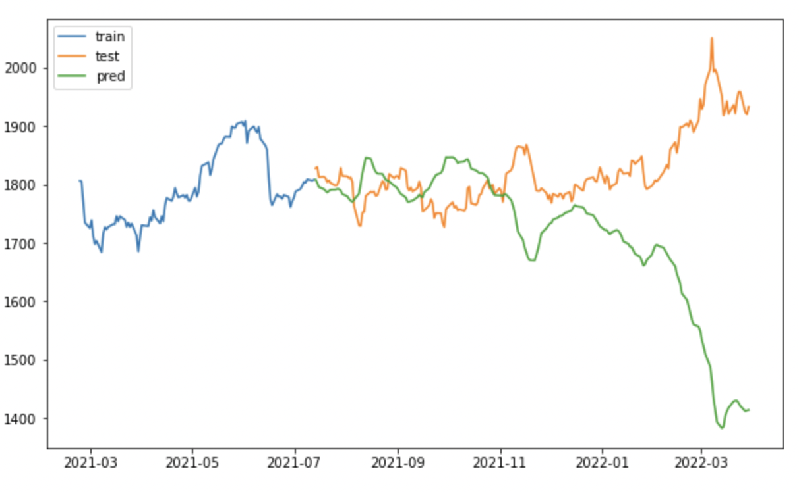
SARIMAX (5,1,5) X (0,1,0,5) w Rolling Avg 5/10/20
RMSE: 204

Slide 50
Backtesting SARIMA
Train
JAN 1 | JAN 2 | JAN 3 (today)
Test
JAN 4 (next day) | JAN 5,6,7…
Backtest from Jan 4 onwards until it hits take profit/stop loss
Jan 4 Prediction
If Prediction> Jan 3: Long
If Prediction< Jan 3: Short
Notes:
Explain that everyday we will take 1 position. Backtesting is to record profit/loss
Train period is from 2015 to 2021 July
Prediction period is from 2021 July to 2022 Mar

Slide 51
Backtesting SARIMA
Train
JAN 1 | JAN 2 | JAN 3 (today)
Test
JAN 4 | JAN 5
New Train
JAN 1 | JAN 2 | JAN 3 | JAN 4
Test
JAN 5 | JAN 6
Backtest from Jan 5 bid/ask close onwards
Jan 5 Prediction
If Prediction> Jan 4: Long
If Prediction< Jan 4: Short
Notes:
Extending training set

Slide 52
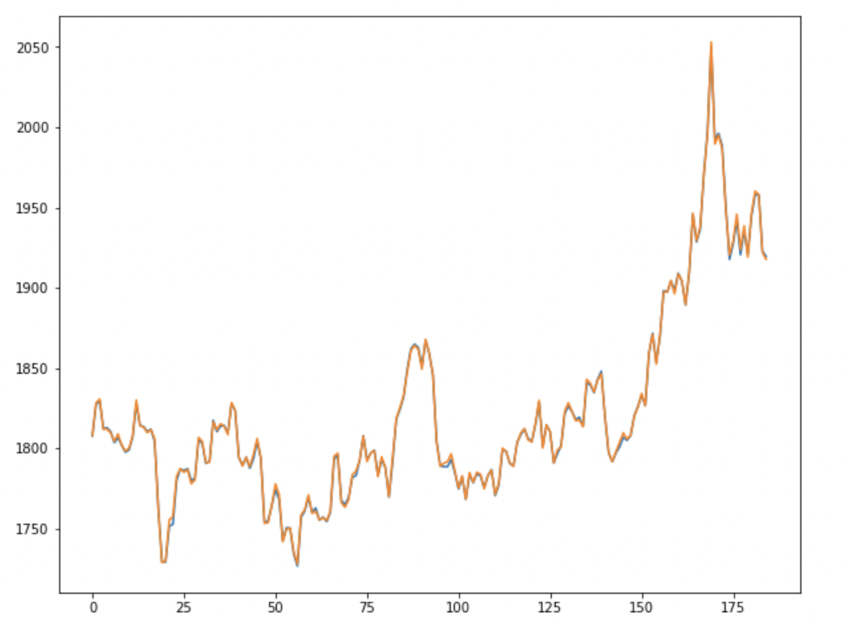
Predictions vs Actual

Slide 53
Backtesting Results
SARIMA (5,1,5) X (0,1,0,5)
Success Count | 89 (48%)
Fail Count | 96 (52%)
Total Profit | -$2.81

